Slide 1
2 DIGIT COUNTER (STOP WATCH)
School of Electronics and Communication Engineering
ANKITA (R22EN007)
B.SHOBHA (R22EN011)
BINDU.K.S (R22EN016)
LATHASHREE.M.S. (R22EN037)

Slide 2
contents
Introduction
Circuit Diagram
Components list
Working process
Applications
Advantages
Disadvantages
Result
Conclusion
Reference

Slide 3
Introduction
A 2-digit counter is a counting device with two separate displays for seconds. It allows users to measure elapsed time precisely.
Pressing the start button initiates the counting, while the stop button halts it, enabling accurate time measurement for various activities such as sports, cooking, or experiments. The clear/reset button resets the counters to zero.
This compact device is widely used for its simplicity and effectiveness in tracking short-duration events.

Slide 4
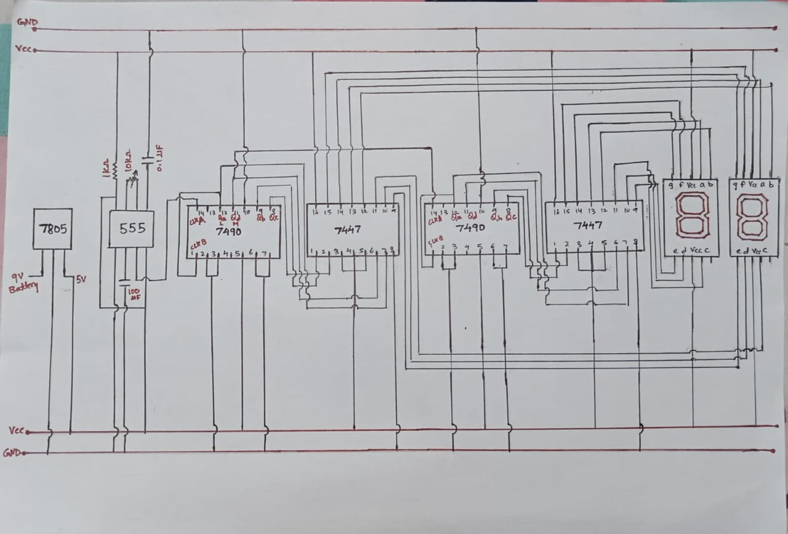
Circuit Diagram

Slide 5
Components list
555 Timer IC
IC 7447 Decoder
IC 7490 Decade Counter
Capacitors
Resistors
Potentiometer (10k)
Common Anode Seven Segment Display
7805 Voltage Regulator
LED

Slide 6
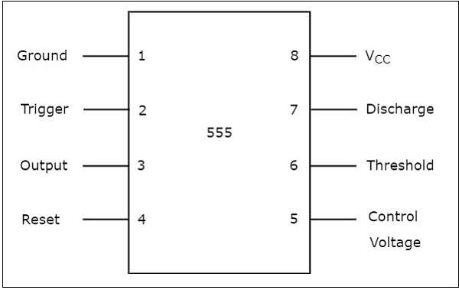
Components
555 Timer IC:Configure the 555 timer in astable mode to generate clock pulses. Adjust the resistor and capacitor values to control the frequency of the clock pulses.A 555 timer IC can be configured as an astable multivibrator to generate clock pulses for a 2-digit counter. Connect the output of the 555 timer to the clock input of the counter. Adjust the resistor and capacitor values in the 555 timer circuit to control the clock frequency, which determines the counting speed of the 2-digit counter.

Slide 7
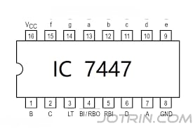
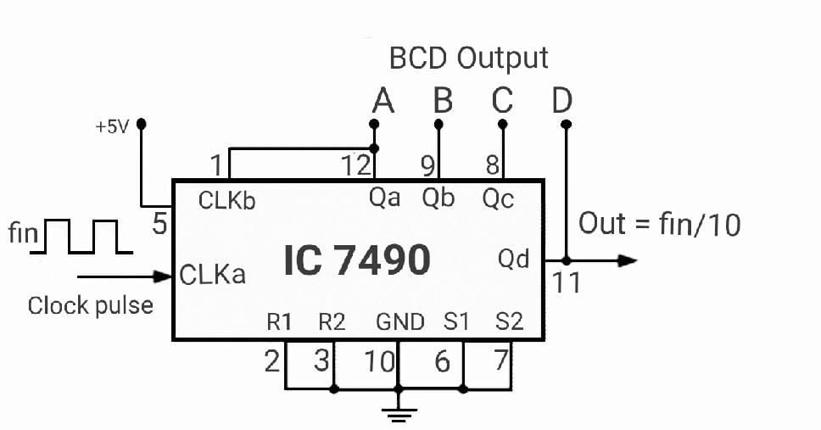
IC 7447
Connect the BCD outputs (QA, QB, QC, QD) of the 7490 counter to the BCD inputs (A, B, C, D) of the 7447.Connect the 7447 outputs (a, b, c, d, e, f, g) to a 7-segment display.Exploring its BCD to 7-segment latch/decoder/drivers for the display.
IC7490
Investigating its decade counter/divider functionality, which can be configured to count seconds, minutes, etc.Connect the output of the 555 timer to the clock input (pin 14) of the 7490 counter.Use the QD (pin 11) output of the 7490 as the external reset for the counter.

Slide 8
Working process
7490 Decade Counter:This IC divides the input frequency by 10 and provides four BCD (Binary Coded Decimal) outputs. Connect the appropriate pins for clock input, clear, and the BCD outputs.
555 Timer: Configure the 555 timer in astable mode to generate clock pulses for the 7490 counter. Adjust the resistor and capacitor values to set the desired frequency.
7447 BCD to 7-Segment Decoder/Driver: This IC takes the BCD outputs from the 7490 counter and converts them into signals to drive a 7-segment display. Connect the appropriate pins for BCD inputs and 7-segment display outputs.
Seven-Segment Display: Connect the 7-segment display to the outputs of the 7447 decoder. Repeat the process for the second digit.Ensure proper power supply and ground connections for all components.

Slide 9
Applications
Digital Timers
Digital Displays
Automated Counting Systems
Laboratory Experiments
Sports Timing
Traffic Light Control
Experimental Psychology

Slide 10
Advantages
Compact Design
Cost-Effective
Improved Readability
Battery Efficiency
Integrated Design
Compact Design

Slide 11
Disadvantages
Limited Count Range
Propagation Delay
Size and Space
Learning Curve
Limited Flexibility
Component Count

Slide 12
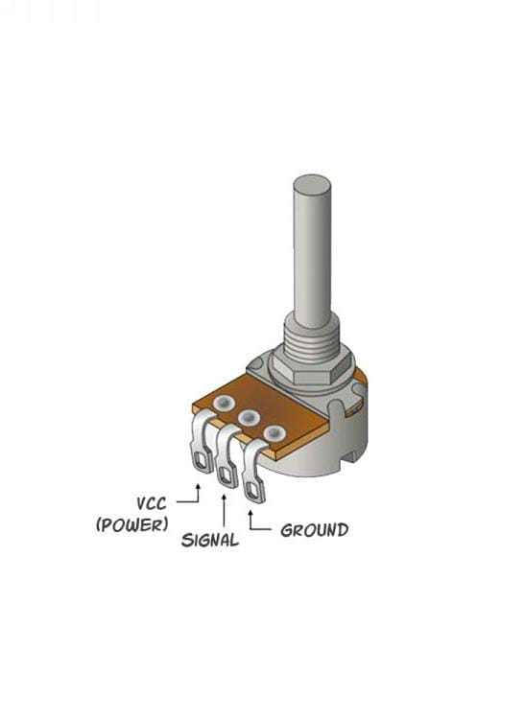
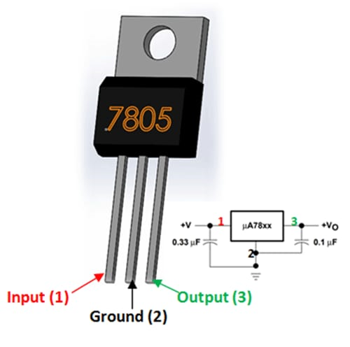
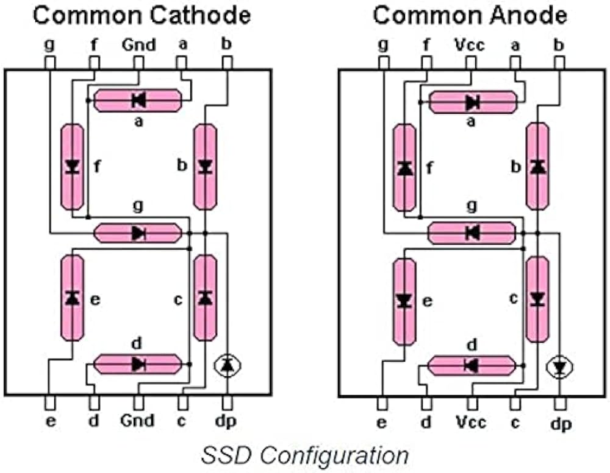
Components

Slide 13
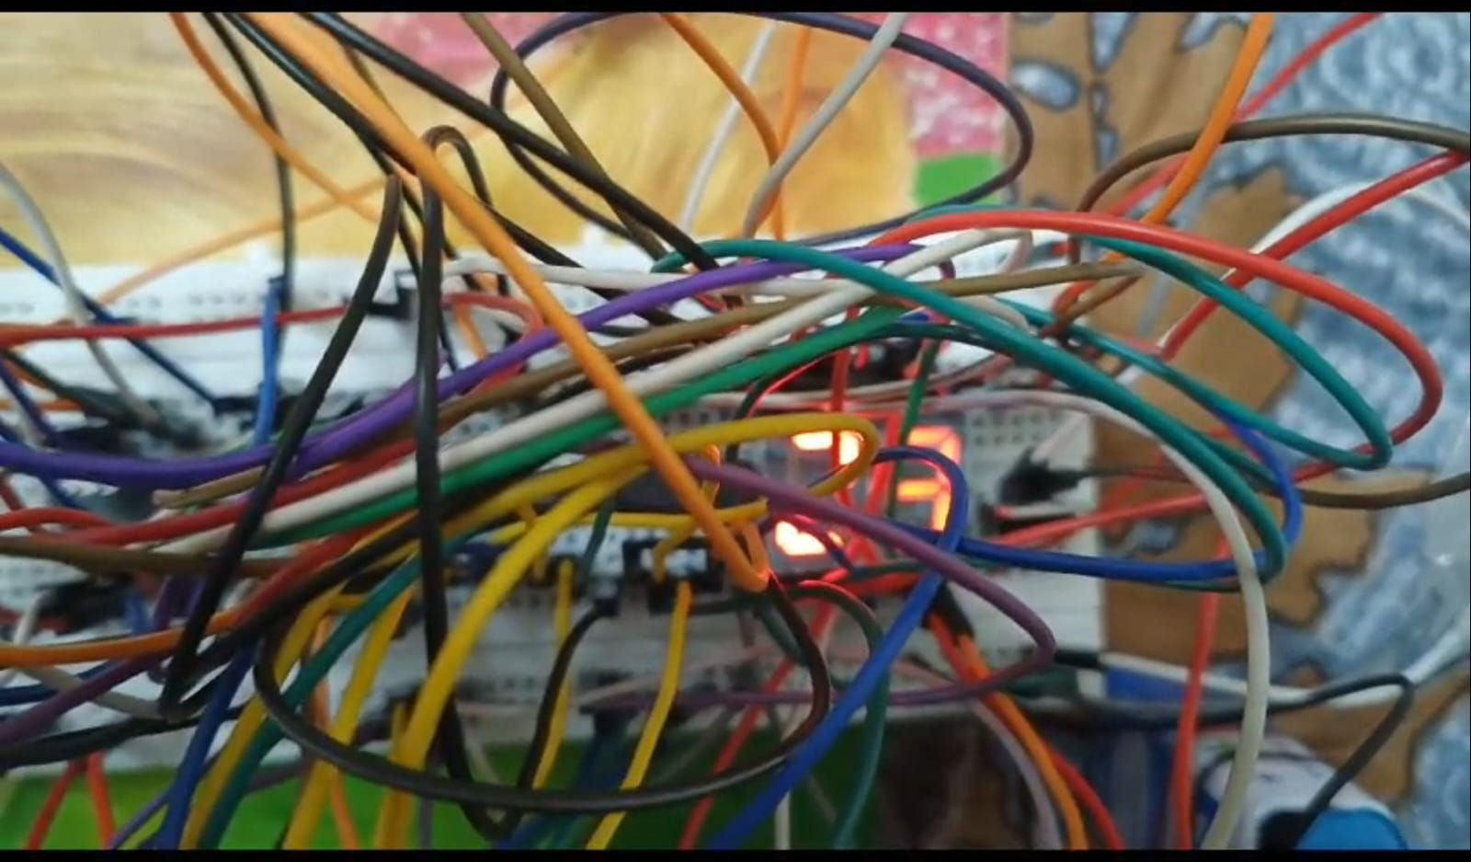
Result
The 2-digit counter implemented as a stopwatch using IC 7447, 7490, and a 555 timer yields a reliable and functional timekeeping solution. The IC 7490 serves as a decade counter, dividing the input frequency by 10, and the IC 7447 converts the BCD output to a format suitable for a 7-segment display.

Slide 14
Conclusion
In conclusion, the integration of IC 7447, 7490, and a 555 timer in a 2-digit counter stopwatch results in a robust and functional timekeeping solution. The IC 7490 serves as a decade counter, dividing the input frequency, while IC 7447 converts the BCD output for clear representation on a 7-segment display. The addition of the 555 timer enhances accuracy by providing a precise time base.
This design creates a stopwatch capable of accurately measuring elapsed time, with the 2-digit display offering clear readability. The synergy between these components ensures a reliable and versatile stopwatch suitable for diverse applications requiring accurate timekeeping.

Slide 15
References
Digital Design: Principles and Practices" by John F. Wakerly
Electronics: A Systems Approach" by Neil Storey
Practical Electronics for Inventors" by Paul Scherz and Simon Monk
555 Timer IC Circuits" by Forrest Mims
https://chat.openai.com/
https://www.google.com/

